Slide 1
Cyberbullying Detection on Social Media
Anurag Rajendra Watane
11013614

Slide 2

What is Cyberbullying?
The term “Cyberbullying” means, use of Information Technology to harm or harass other people in a deliberate, repeated, and hostile manner
Mean text messages, spreading rumours, posting messages, and sharing embarrassing photos and videos on social networking sites are all examples of cyberbullying
Fat
Ugly
What Is Cyberbullying | StopBullying.gov

Slide 3
Twitter Dataset
Combined Data
Training Set (10788 rows)
Cyberbullying (4532 rows)
Not (6256 rows)
Testing Set (2697 rows)
HASOC 2019
HASOC 2020
Kaggle
Combined Data
Total 13485 rows
HASOC (hasocfire.github.io)
UMICH SI650 - Sentiment Classification | Kaggle

Slide 4
What is BERT?
Bidirectional Encoder Representations from Transformers
It is based on the Transformer architecture
BERT is pre-trained on a large corpus of unlabelled text
Wikipedia (2500 M words)
Book Corpus (800 M words)

Slide 5
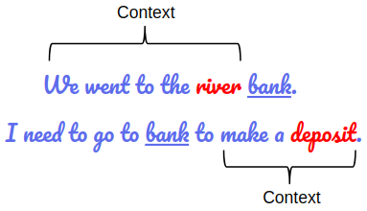
Why Bidirectional?
It uses multilayer bidirectional transformer encoders for language representations
BERT is a “deeply bidirectional” model. Bidirectional means that BERT learns information from both the left and the right side of a token’s context during the training phase
What is BERT | BERT For Text Classification (analyticsvidhya.com)

Slide 6
Why pretrained model?
The pre-trained BERT model weights already encode a lot of information about our language
Because of the pre-trained weights this method allows us to fine-tune our task on a much smaller dataset
It takes much less time to fine-tune the model

Slide 7
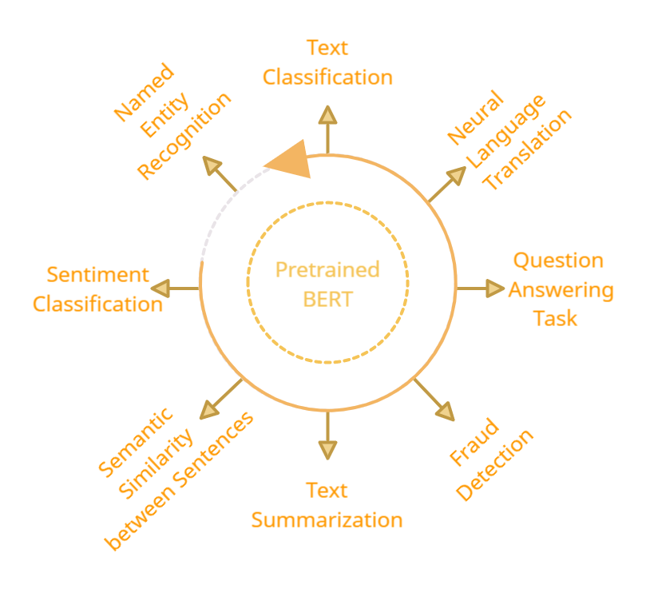
Advantages of pre-trained model
Fine Tune with one additional layer
BERT uses the concept of fine-tuning, and the final model for any task is almost the same as BERT.

Slide 8
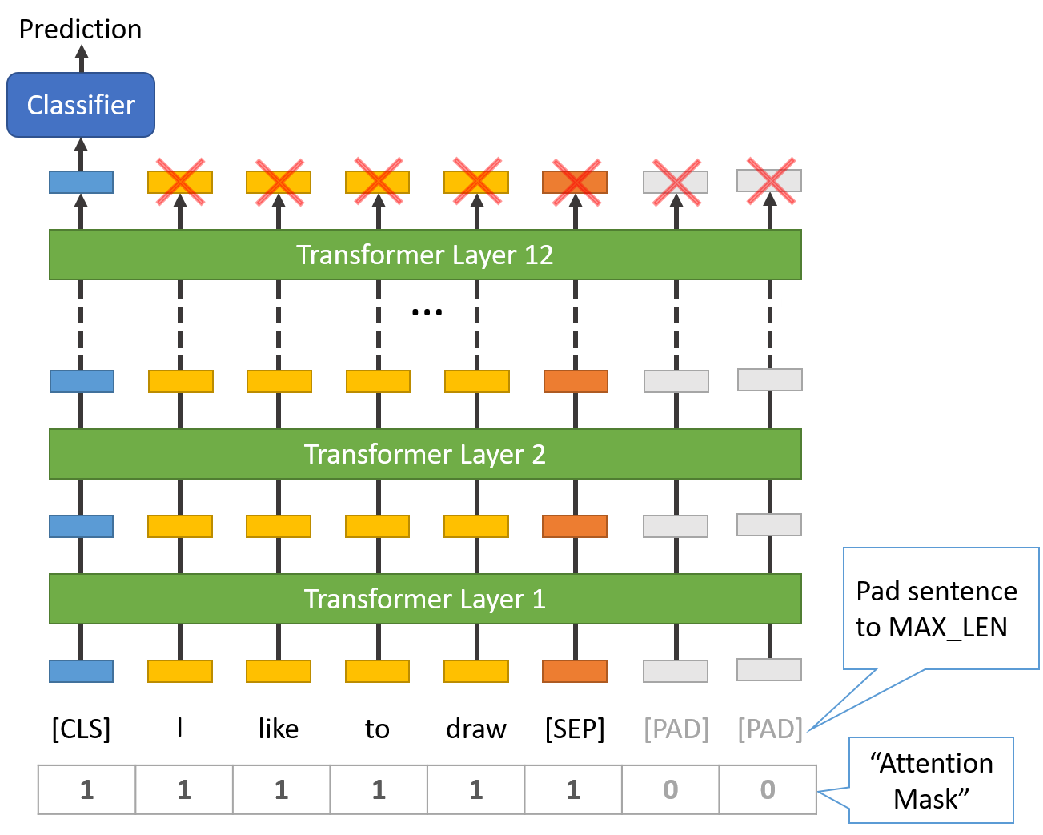
Architecture Used
12-layer, 768-hidden, 12-heads, 110M parameters
I have used pre-trained weights of ‘bert-base-uncased’ to fine-tune the model on Twitter dataset
This model is uncased: it does not make a difference between english and English
BERT Fine-Tuning Tutorial with PyTorch · Chris McCormick (mccormickml.com)

Slide 9
Architecture Used
12-layer, 768-hidden, 12-heads, 110M parameters
Pre-trained weights of ‘bert-base-uncased’ are used to fine-tune the model on Twitter dataset
This model is uncased: it does not make a difference between english and English
BERT Fine-Tuning Tutorial with PyTorch · Chris McCormick (mccormickml.com)

Slide 10
Architecture Used
12-layer, 768-hidden, 12-heads, 110M parameters
I have used pre-trained weights of ‘bert-base-uncased’ to fine-tune the model on Twitter dataset
This model is uncased: it does not make a difference between english and English
BERT Fine-Tuning Tutorial with PyTorch · Chris McCormick (mccormickml.com)

Slide 11
Architecture Used
12-layer, 768-hidden, 12-heads, 110M parameters
I have used pre-trained weights of ‘bert-base-uncased’ to fine-tune the model on Twitter dataset
This model is uncased: it does not make a difference between english and English
BERT Fine-Tuning Tutorial with PyTorch · Chris McCormick (mccormickml.com)

Slide 12
Steps for fine-tuning BERT
Encode Target Variable
Tokenize Each Sentence
Train-Test Split
Load Pre-trained BERT
Train on Twitter Data
Evaluate on Test Set

Slide 13
Steps for fine-tuning BERT
Encode Target Variable
Tokenize Each Sentence
Train-Test Split
Load Pre-trained BERT
Train on Twitter Data
Evaluate on Test Set

Slide 14
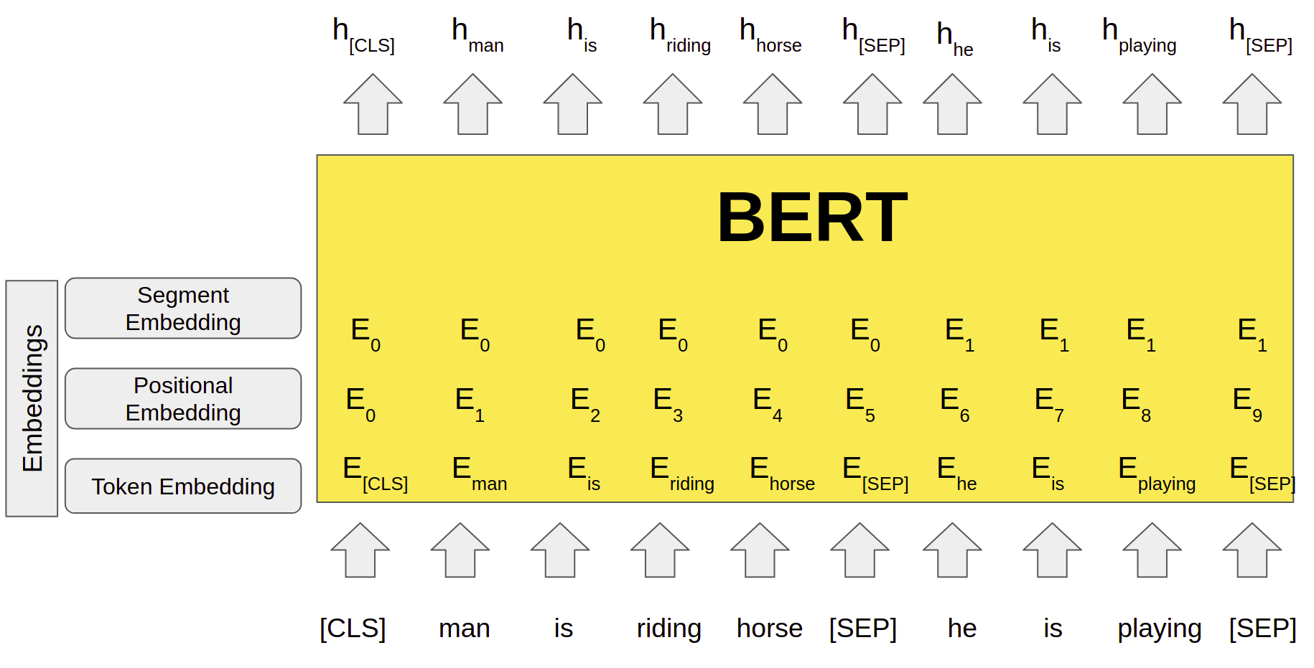
Tokenization for BERT
BERT uses special tokens [CLS] and [SEP] to understand input properly
[SEP] token has to be inserted at the end of every sentence
The first token of every input sequence is the special classification token – [CLS]
The last hidden state of BERT, corresponding to this token ( h[CLS] ) is used in classification tasks as an aggregate of the entire sequence representation
BERT for Natural Language Processing |All You Need to know about BERT (analyticsvidhya.com)

Slide 15
Tokenization for BERT
BERT uses special tokens [CLS] and [SEP] to understand input properly
[SEP] token has to be inserted at the end of every sentence
The first token of every input sequence is the special classification token – [CLS]
The last hidden state of BERT, corresponding to this token ( h[CLS] ) is used in classification tasks as an aggregate of the entire sequence representation
BERT for Natural Language Processing |All You Need to know about BERT (analyticsvidhya.com)

Slide 16
Tokenization for BERT
BERT uses special tokens [CLS] and [SEP] to understand input properly
[SEP] token has to be inserted at the end of every sentence
The first token of every input sequence is the special classification token – [CLS]
The last hidden state of BERT, corresponding to this token ( h[CLS] ) is used in classification tasks as an aggregate of the entire sequence representation
BERT for Natural Language Processing |All You Need to know about BERT (analyticsvidhya.com)

Slide 17
Tokenization for BERT
BERT uses special tokens [CLS] and [SEP] to understand input properly
[SEP] token has to be inserted at the end of every sentence
The first token of every input sequence is the special classification token – [CLS]
The last hidden state of BERT, corresponding to this token ( h[CLS] ) is used in classification tasks as an aggregate of the entire sequence representation
BERT for Natural Language Processing |All You Need to know about BERT (analyticsvidhya.com)

Slide 18
Tokenization for BERT
BERT uses special tokens [CLS] and [SEP] to understand input properly
[SEP] token has to be inserted at the end of every sentence
The first token of every input sequence is the special classification token – [CLS]
The last hidden state of BERT, corresponding to this token ( h[CLS] ) is used in classification tasks as an aggregate of the entire sequence representation
BERT for Natural Language Processing |All You Need to know about BERT (analyticsvidhya.com)

Slide 19
Tokenization for BERT
BERT uses special tokens [CLS] and [SEP] to understand input properly
[SEP] token has to be inserted at the end of every sentence
The first token of every input sequence is the special classification token – [CLS]
The last hidden state of BERT, corresponding to this token ( h[CLS] ) is used in classification tasks as an aggregate of the entire sequence representation
BERT for Natural Language Processing |All You Need to know about BERT (analyticsvidhya.com)

Slide 20
Steps for fine-tuning BERT
Encode Target Variable
Tokenize Each Sentence
Train-Test Split
Load Pre-trained BERT
Train on Twitter Data
Evaluate on Test Set

Slide 21
Steps for fine-tuning BERT
Encode Target Variable
Tokenize Each Sentence
Train-Test Split
Load Pre-trained BERT
Train on Twitter Data
Evaluate on Test Set

Slide 22
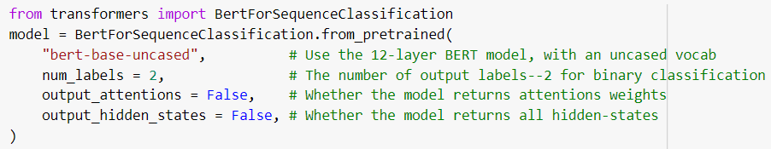
Load pretrained BERT
BertForSequenceClassification is used to load the pre-trained BERT model from ‘transformers’ library developed by company Hugging Face
The BertForSequenceClassification is used to fine-tune the BERT model
BertForSequenceClassification is the normal BERT model with an added single linear layer on top for classification

Slide 23
Steps for fine-tuning BERT
Encode Target Variable
Tokenize Each Sentence
Train-Test Split
Load Pre-trained BERT
Train on Twitter Data
Evaluate on Test Set

Slide 24
Steps for fine-tuning BERT
Encode Target Variable
Tokenize Each Sentence
Train-Test Split
Load Pre-trained BERT
Train on Twitter Data
Evaluate on Test Set

Slide 25
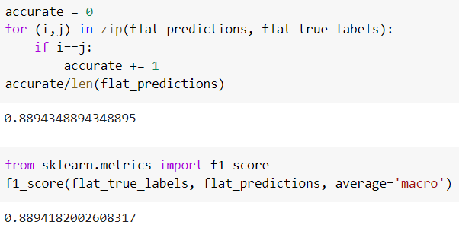
F1 Score: BERT

Slide 26
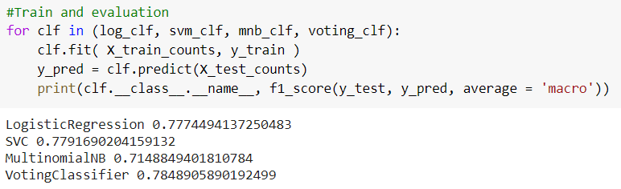
F1 Score: Ensemble Model

Slide 27
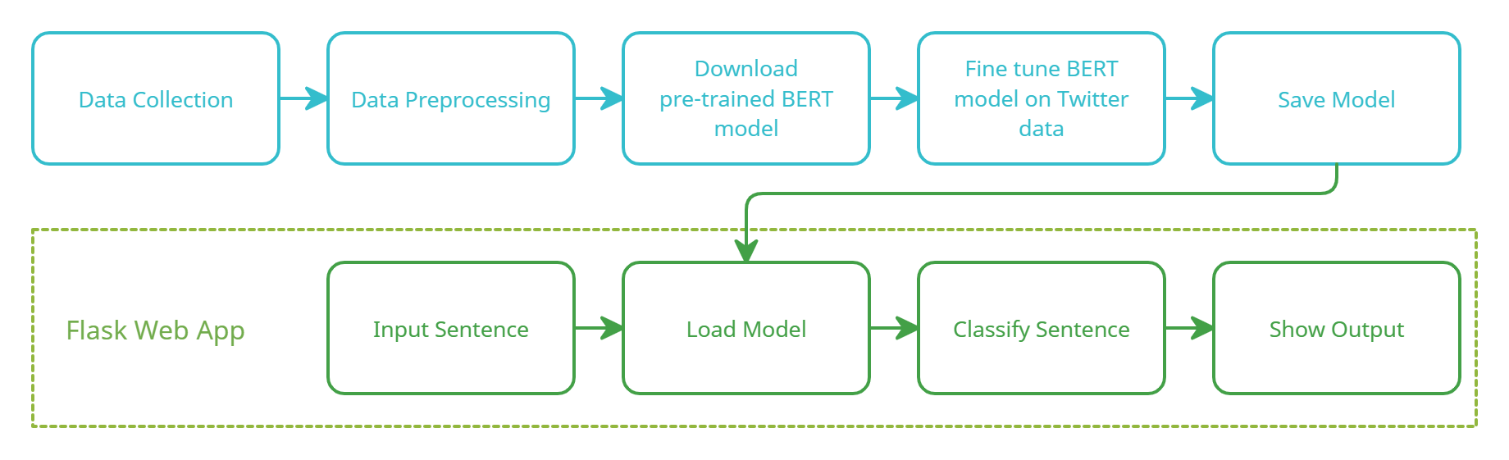
Pipeline

Slide 28
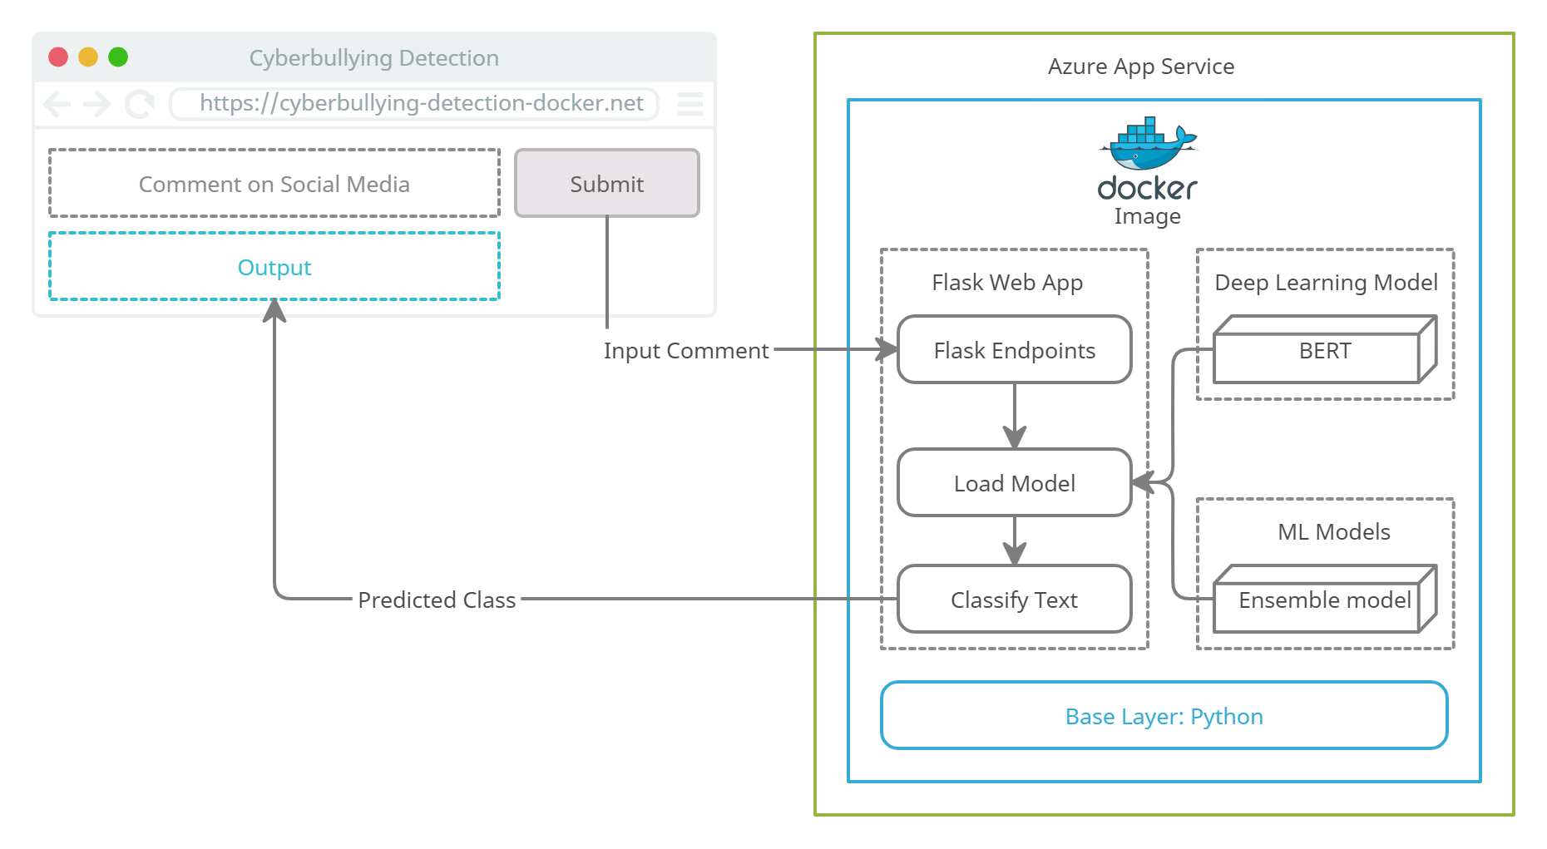
Framework

Slide 29
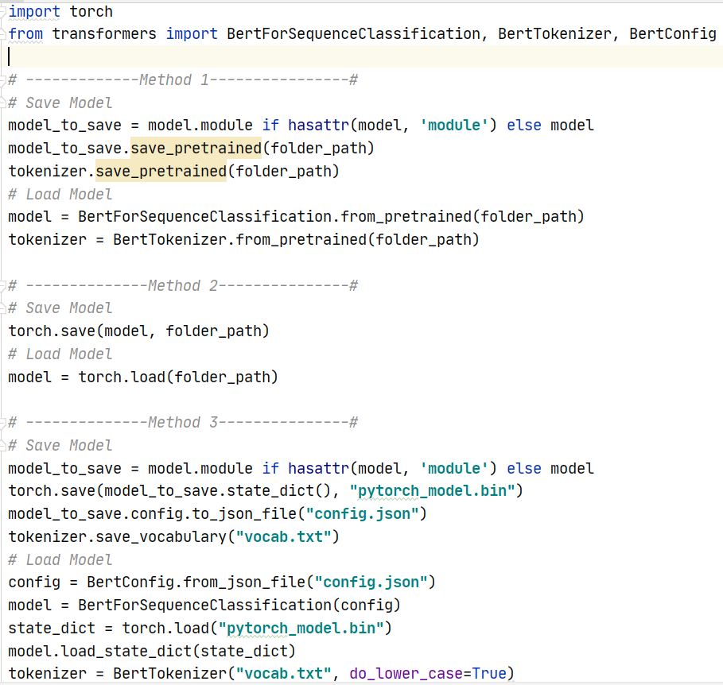
Challenges
Loading the BERT model failed with Flask Web App on Azure Linux
I tried three different approaches to load the BERT model, but none of them worked on Azure Linux Machine. On the other hand, all three ways work on the local machine
Flask App on Azure: Cyberbullying Detection (cyberbullying-detection.azurewebsites.net)

Slide 30
Solution
Deployed the Flask App to Azure as a Docker container
Docker image of Flask App on Azure: Cyberbullying Detection (cyberbullying-detection-docker.azurewebsites.net)

Slide 31
Future Scope
Training BERT on data with more than two classes
Comparison of BERT with Ensemble model for more than 2 classes

Slide 32
References
Dataset 1: HASOC (hasocfire.github.io)
Dataset 2: UMICH SI650 - Sentiment Classification | Kaggle
What Is Cyberbullying | StopBullying.gov
What is BERT | BERT For Text Classification (analyticsvidhya.com)
BERT Fine-Tuning Tutorial with PyTorch · Chris McCormick (mccormickml.com)
BERT for Natural Language Processing |All You Need to know about BERT (analyticsvidhya.com)

Slide 33
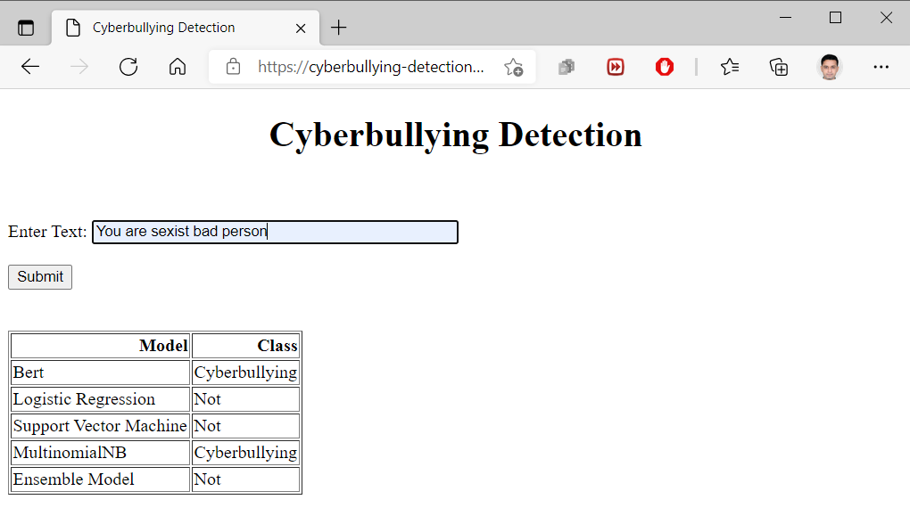
Demo
https://cyberbullying-detection-docker.azurewebsites.net/

Slide 34
Thank You!

